Slide 1
Module-4 PL-FOL

Slide 2
Propositional logic (PL)

Slide 3
Propositional logic (PL)
Propositional logic (PL) is the simplest form of logic where all the statements are made by propositions. A proposition is a declarative statement which is either true or false. It is a technique of knowledge representation in logical and mathematical form.
Example:
a) It is Sunday.
b) The Sun rises from West (False proposition)
c) 3+3= 7(False proposition)
d) 5 is a prime number.

Slide 4
Following are some basic facts about propositional logic:
Propositional logic is also called Boolean logic as it works on 0 and 1.
In propositional logic, we use symbolic variables to represent the logic, and we can use any symbol for a representing a proposition, such A, B, C, P, Q, R, etc.
Propositions can be either true or false, but it cannot be both.
Propositional logic consists of an object, relations or function, and logical connectives.
These connectives are also called logical operators.
The propositions and connectives are the basic elements of the propositional logic.
Connectives can be said as a logical operator which connects two sentences.
A proposition formula which is always true is called tautology, and it is also called a valid sentence.
A proposition formula which is always false is called Contradiction.
A proposition formula which has both true and false values is called Statements
Questions, commands, or opinions are not propositions such as "Where is Rohini", "How are you", "What is your name", are not propositions.

Slide 5
Syntax of propositional logic:
The syntax of propositional logic defines the allowable sentences for the knowledge representation. There are two types of Propositions:
Atomic Propositions:
Compound propositions

Slide 6
Atomic Proposition:
Atomic propositions are the simple propositions. It consists of a single proposition symbol. These are the sentences which must be either true or false.
Example:
a) 2+2 is 4, it is an atomic proposition as it is a true fact.
b) "The Sun is cold" is also a proposition as it is a false fact.

Slide 7
Compound proposition:
Compound propositions are constructed by combining simpler or atomic propositions, using parenthesis and logical connectives.
Example:
a) "It is raining today, and street is wet."
b) "Ankit is a doctor, and his clinic is in Mumbai."

Slide 8
Logical Connectives:
Logical connectives are used to connect two simpler propositions or representing a sentence logically. We can create compound propositions with the help of logical connectives. There are mainly five connectives, which are given as follows:
Negation: A sentence such as ¬ P is called negation of P. A literal can be either Positive literal or negative literal.
Conjunction: A sentence which has ∧ connective such as, P ∧ Q is called a conjunction. Example: Rohan is intelligent and hardworking. It can be written as, P= Rohan is intelligent, Q= Rohan is hardworking. → P∧ Q.
Disjunction: A sentence which has ∨ connective, such as P ∨ Q. is called disjunction, where P and Q are the propositions. Example: "Ritika is a doctor or Engineer", Here P= Ritika is Doctor. Q= Ritika is Engineer, so we can write it as P ∨ Q.

Slide 9
Logical Connectives:
Implication: A sentence such as P → Q, is called an implication. Implications are also known as if-then rules. It can be represented as If it is raining, then the street is wet. Let P= It is raining, and Q= Street is wet, so it is represented as P → Q
Biconditional: A sentence such as P⇔ Q is a Biconditional sentence, example If I am breathing, then I am alive P= I am breathing, Q= I am alive, it can be represented as P ⇔ Q.

Slide 10
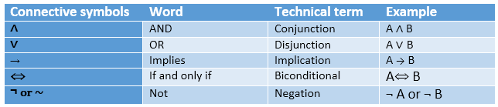

Slide 11
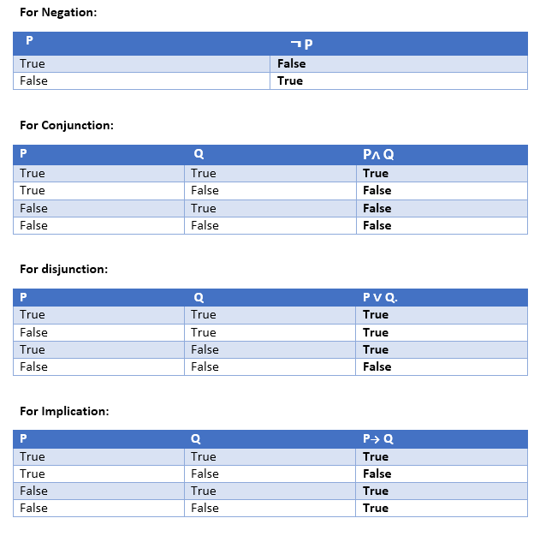
Truth Table:
In propositional logic, we need to know the truth values of propositions in all possible scenarios. We can combine all the possible combination with logical connectives, and the representation of these combinations in a tabular format is called Truth table. Following are the truth table for all logical connectives:

Slide 13
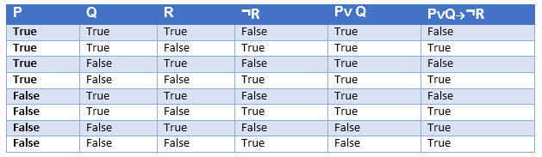
Truth table with three propositions:
We can build a proposition composing three propositions P, Q, and R. This truth table is made-up of 8n Tuples as we have taken three proposition symbols

Slide 14
Properties of Operators:
Commutativity:
P∧ Q= Q ∧ P, or
P ∨ Q = Q ∨ P.
Associativity:
(P ∧ Q) ∧ R= P ∧ (Q ∧ R),
(P ∨ Q) ∨ R= P ∨ (Q ∨ R)
Identity element:
P ∧ True = P,
P ∨ True= True.
Distributive:
P∧ (Q ∨ R) = (P ∧ Q) ∨ (P ∧ R).
P ∨ (Q ∧ R) = (P ∨ Q) ∧ (P ∨ R).
DE Morgan's Law:
¬ (P ∧ Q) = (¬P) ∨ (¬Q)
¬ (P ∨ Q) = (¬ P) ∧ (¬Q).
Double-negation elimination:
¬ (¬P) = P.

Slide 15
Limitations of Propositional logic:
We cannot represent relations like ALL, some, or none with propositional logic. Example:
All the girls are intelligent.
Some apples are sweet.
Propositional logic has limited expressive power.
In propositional logic, we cannot describe statements in terms of their properties or logical relationships.

Slide 17
First Order Logic (FOL)

Slide 18
Key differences between PL and FOL
Propositional Logic converts a complete sentence into a symbol and makes it logical whereas in First-Order Logic relation of a particular sentence will be made that involves relations, constants, functions, and constants.
The limitation of PL is that it does not represent any individual entities whereas FOL can easily represent the individual establishment that means if you are writing a single sentence then it can be easily represented in FOL.
PL does not signify or express the generalization, specialization or pattern for example ‘QUANTIFIERS’ cannot be used in PL but in FOL users can easily use quantifiers as it does express the generalization, specialization, and pattern.

Slide 19
First-order logic (FOL)
First-order logic is capable of expressing facts about some or all objects in the universe.
Substitution: Substitution is a fundamental operation performed on terms and formulas. It occurs in all inference systems in first-order logic. The substitution is complex in the presence of quantifiers in FOL. If we write F[a/x], so it refers to substitute a constant "a" in place of variable "x".
Equality: First-Order logic does not only use predicate and terms for making atomic sentences but also uses another way, which is equality in FOL. For this, we can use equality symbols which specify that the two terms refer to the same object.
Example: Brother (John) = Smith.

Slide 20
FOL inference rules for quantifier:
As propositional logic we also have inference rules in first-order logic, so following are some basic inference rules in FOL:
Universal Generalization
Universal Instantiation
Existential Instantiation
Existential introduction

Slide 21

1. Universal Generalization:
Universal generalization is a valid inference rule which states that if premise P(c) is true for any arbitrary element c in the universe of discourse, then we can have a conclusion as ∀ x P(x).
It can be represented as:
This rule can be used if we want to show that every element has a similar property.
In this rule, x must not appear as a free variable.
Example: Let's represent, P(c): "A byte contains 8 bits", so for ∀ x P(x) "All bytes contain 8 bits.", it will also be true.

Slide 22

2. Universal Instantiation:
Universal instantiation is also called as universal elimination or UI is a valid inference rule. It can be applied multiple times to add new sentences.
The new KB is logically equivalent to the previous KB.
As per UI, we can infer any sentence obtained by substituting a ground term for the variable.
The UI rule state that we can infer any sentence P(c) by substituting a ground term c (a constant within domain x) from ∀ x P(x) for any object in the universe of discourse.
It can be represented as:

Slide 23
2. Universal Instantiation:
Example:1.
IF "Every person like ice-cream"=> ∀x P(x) so we can infer that "John likes ice-cream" => P(c)
Example: 2.
Let's take a famous example,
"All kings who are greedy are Evil." So let our knowledge base contains this detail as in the form of FOL:
∀x king(x) ∧ greedy (x) → Evil (x),
So from this information, we can infer any of the following statements using Universal Instantiation:
King(John) ∧ Greedy (John) → Evil (John),
King(Richard) ∧ Greedy (Richard) → Evil (Richard),
King(Father(John)) ∧ Greedy (Father(John)) → Evil (Father(John)),

Slide 24

3. Existential Instantiation:
Existential instantiation is also called as Existential Elimination, which is a valid inference rule in first-order logic.
It can be applied only once to replace the existential sentence.
The new KB is not logically equivalent to old KB, but it will be satisfiable if old KB was satisfiable.
This rule states that one can infer P(c) from the formula given in the form of ∃x P(x) for a new constant symbol c.
The restriction with this rule is that c used in the rule must be a new term for which P(c ) is true.
It can be represented as:

Slide 25
3. Existential Instantiation:
Example:
From the given sentence: ∃x Crown(x) ∧ OnHead(x, John),
So we can infer: Crown(K) ∧ OnHead( K, John), as long as K does not appear in the knowledge base.
The above used K is a constant symbol, which is called Skolem constant.
The Existential instantiation is a special case of Skolemization process.

Slide 26

4. Existential introduction
An existential introduction is also known as an existential generalization, which is a valid inference rule in first-order logic.
This rule states that if there is some element c in the universe of discourse which has a property P, then we can infer that there exists something in the universe which has the property P.
It can be represented as:
Example: Let's say that,
"Priyanka got good marks in English."
"Therefore, someone got good marks in English."

Slide 27

Generalized Modus Ponens Rule:
For the inference process in FOL, we have a single inference rule which is called Generalized Modus Ponens. It is lifted version of Modus ponens.
Generalized Modus Ponens can be summarized as, " P implies Q and P is asserted to be true, therefore Q must be True."
According to Modus Ponens, for atomic sentences pi, pi', q. Where there is a substitution θ such that SUBST (θ, pi',) = SUBST(θ, pi), it can be represented as:

Slide 28
Example:
We will use this rule for Kings are evil, so we will find some x such that x is king, and x is greedy so we can infer that x is evil.
Here let say, p1' is king(John) p1 is king(x)
p2' is Greedy(y) p2 is Greedy(x)
θ is {x/John, y/John} q is evil(x)
SUBST(θ,q).

Slide 29
Predicate Logic
Predicate Logic deals with predicates, which are propositions, consist of variables.
Predicate Logic - Definition
A predicate is an expression of one or more variables determined on some specific domain. A predicate with variables can be made a proposition by either authorizing a value to the variable or by quantifying the variable.
The following are some examples of predicates.
Consider E(x, y) denote "x = y"
Consider X(a, b, c) denote "a + b + c = 0"
Consider M(x, y) denote "x is married to y."

Slide 30
Quantifier:
The variable of predicates is quantified by quantifiers. There are two types of quantifier in predicate logic - Existential Quantifier and Universal Quantifier.
Existential Quantifier:
If p(x) is a proposition over the universe U. Then it is denoted as ∃x p(x) and read as "There exists at least one value in the universe of variable x such that p(x) is true. The quantifier ∃ is called the existential quantifier.
There are several ways to write a proposition, with an existential quantifier, i.e.,
(∃x∈A) p(x) or ∃x∈A such that p (x) or (∃x)p(x) or p(x) is true for some x ∈A.
Universal Quantifier:
If p(x) is a proposition over the universe U. Then it is denoted as ∀x,p(x) and read as "For every x∈U, p(x) is true." The quantifier ∀ is called the Universal Quantifier.
There are several ways to write a proposition, with a universal quantifier.
∀x∈A, p(x) or p(x), ∀x ∈A Or ∀x, p(x) or p(x) is true for all x ∈A.

Slide 31
Negation of Quantified Propositions:
When we negate a quantified proposition, i.e., when a universally quantified proposition is negated, we obtain an existentially quantified proposition, and when an existentially quantified proposition is negated, we obtain a universally quantified proposition.
The two rules for negation of quantified proposition are as follows. These are also called DeMorgan's Law.
Example: Negate each of the following propositions:
1.∀x p(x)∧ ∃ y q(y)
Sol: ~.∀x p(x)∧ ∃ y q(y)) ≅~∀ x p(x)∨∼∃yq (y) (∴∼(p∧q)=∼p∨∼q) ≅ ∃ x ~p(x)∨∀y∼q(y)
2. (∃x∈U) (x+6=25)
Sol: ~( ∃ x∈U) (x+6=25)
≅∀ x∈U~ (x+6)=25
≅(∀ x∈U) (x+6)≠25

Slide 32
Propositions with Multiple Quantifiers:
The proposition having more than one variable can be quantified with multiple quantifiers. The multiple universal quantifiers can be arranged in any order without altering the meaning of the resulting proposition. Also, the multiple existential quantifiers can be arranged in any order without altering the meaning of the proposition.
The proposition which contains both universal and existential quantifiers, the order of those quantifiers can't be exchanged without altering the meaning of the proposition, e.g., the proposition ∃x ∀ y p(x,y) means "There exists some x such that p (x, y) is true for every y."
Example: Write the negation for each of the following.
Determine whether the resulting statement is true or false. Assume U = R.
1.∀ x ∃ m(x2<m)
Sol: Negation of ∀ x ∃ m(x2<m) is ∃ x ∀ m (x2≥m). The meaning of ∃ x ∀ m (x2≥m) is that there exists for some x such that x2≥m, for every m. The statement is true as there is some greater x such that x2≥m, for every m.
2. ∃ m∀ x(x2<m)
Sol: Negation of ∃ m ∀ x (x2<m) is ∀ m∃x (x2≥m). The meaning of ∀ m∃x (x2≥m) is that for every m, there exists for some x such that x2≥m. The statement is true as for every m, there exists for some greater x such that x2≥m.

Slide 33
Example of FOL

